Slide 1

Hotel Haven: Predicting Customer Cancellations
A comprehensive data analysis to understand booking patterns, identify cancellation factors, and develop strategies to improve customer retention,
Presented by Ahmed Olatunji (data scientist)

Slide 2
Project Overview
Objectives
Deliverables
Assist Hotel Haven in understanding challenges related to customer cancellations and provide data-driven insights to improve retention.
Data cleaning and preparation
Exploratory data analysis
Comprehensive data analysis
Feature engineering and model development
Model evaluation and fine-tuning

Slide 3
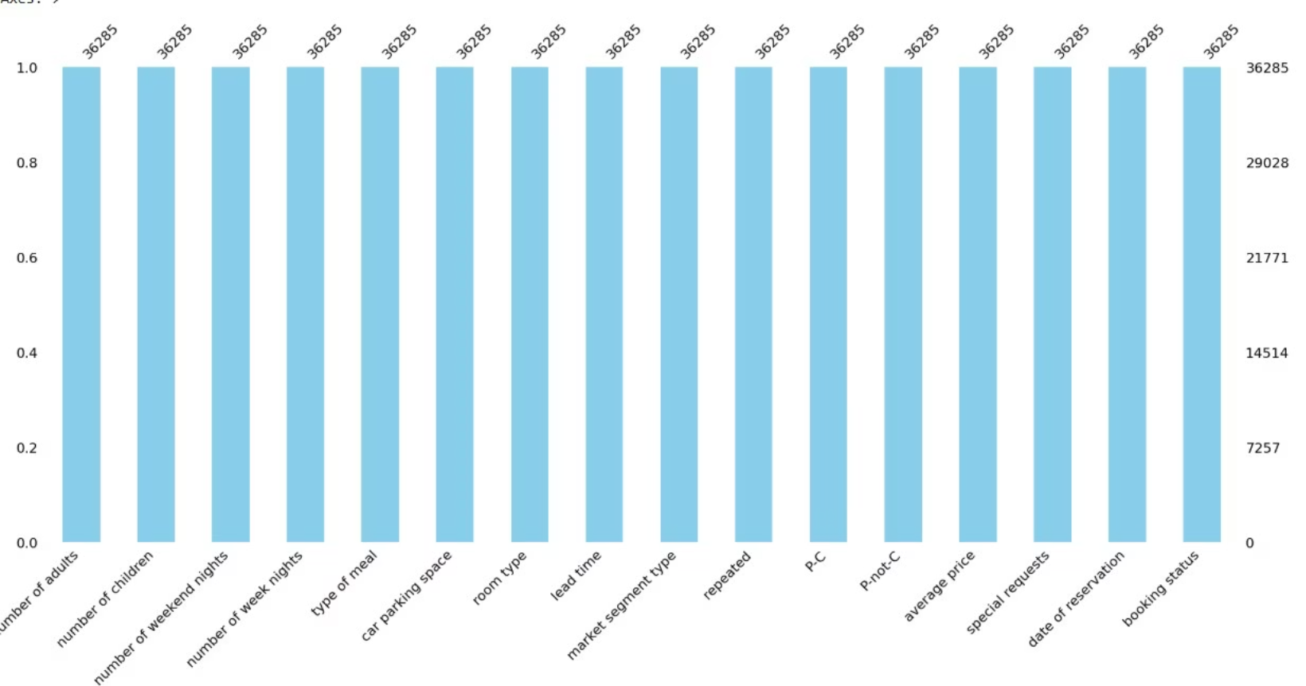
Data Cleaning Process
Key Cleaning Steps
This Data has no missing value
Removed irrelevant columns (booking ID, doesn't contribute to prediction)

Slide 4
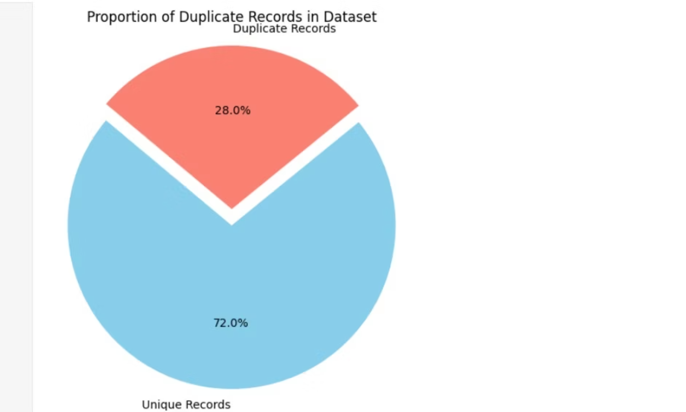
IDENTIFY AND REMOVE DUPLICATES
Eliminated 10,276 duplicate values (28% of data)
Addressed outliers in numerical variables
Corrected 35 invalid dates in reservation records

Slide 5
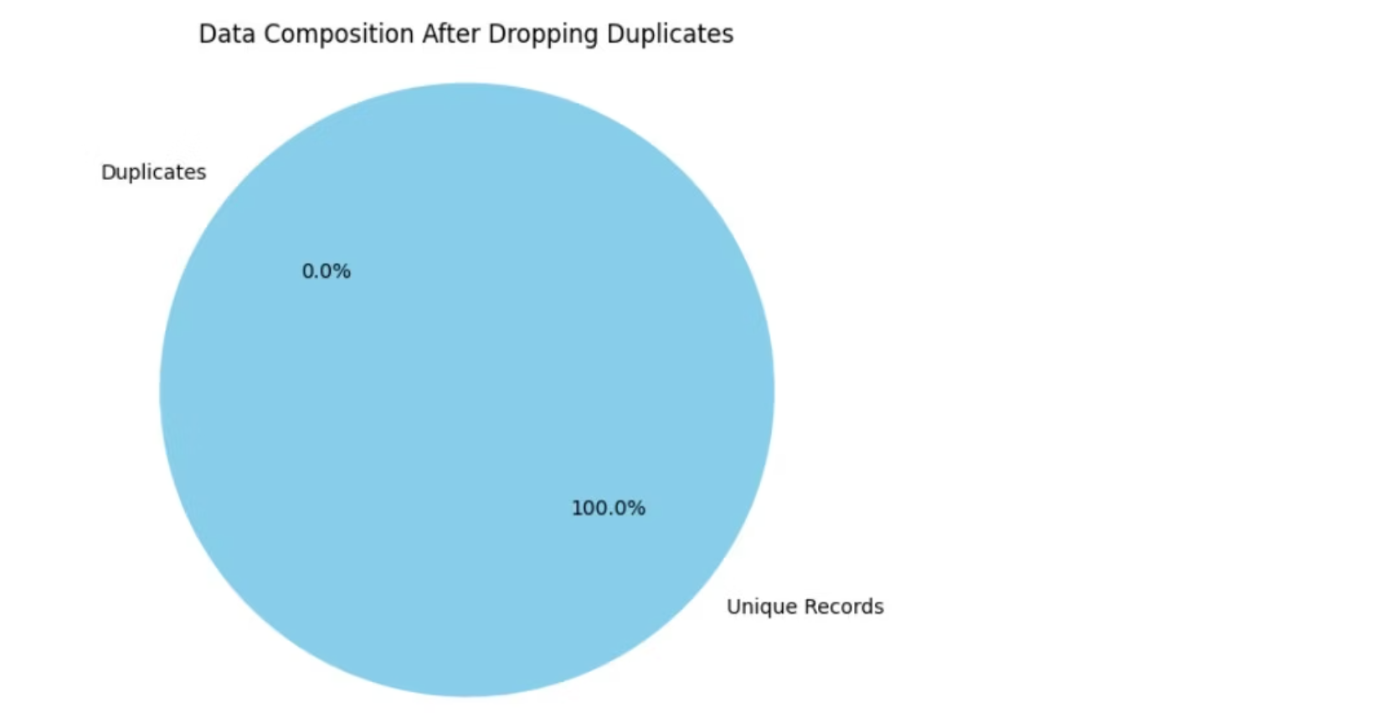
Duplicates cleaned
Result after removing duplicate values, our data can now have an accurate analysis , after duplicate has been removed

Slide 6
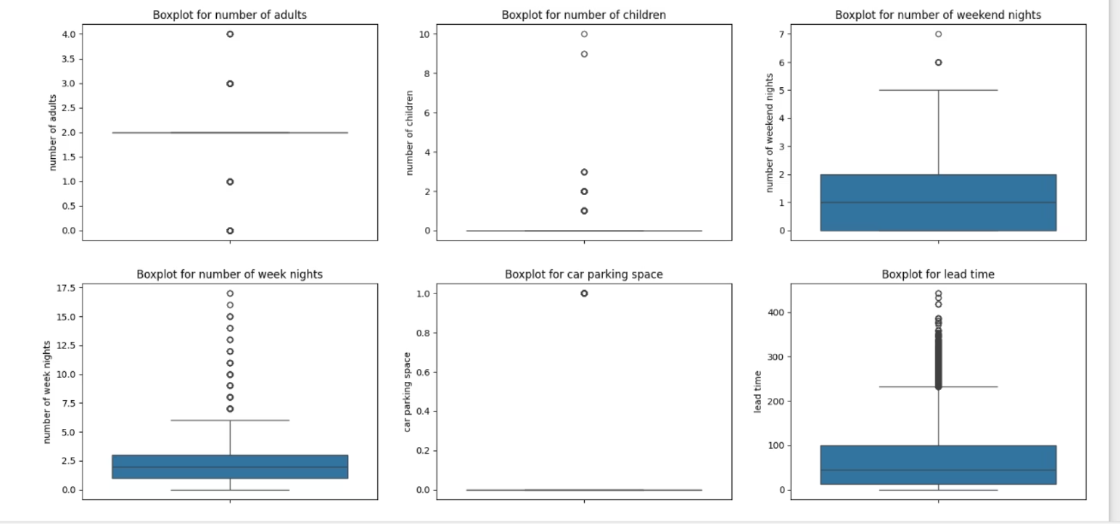
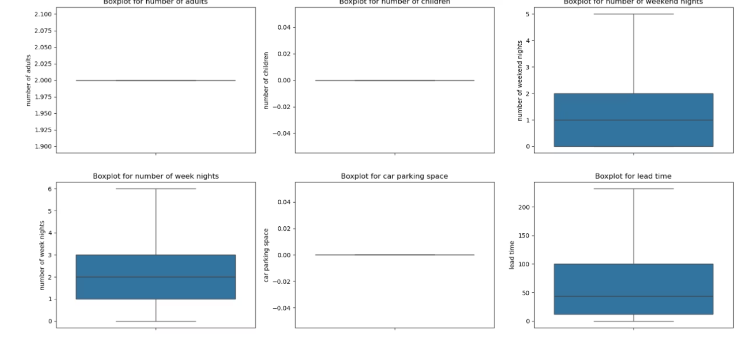
HANDLED OUTLIERS
As part of our data quality improvement initiative, we conducted a thorough analysis of the Hotel Haven booking dataset and identified several outliers that could potentially distort insights and business decisions.
Outliers were found in the following key columns:
Guest & Booking Details: number of adults, number of children, number of weekend nights, number of week nights, car parking space, lead time, repeated
i have documented both the pre- and post-cleaning results to demonstrate the impact of the changes. This enhancement aligns with our goal of leveraging high-quality data to drive operational efficiency , accuracy and customer satisfaction.
Booking Status & Financials: P-C (percentage confirmed), P-not-C (percentage not confirmed), average price, special requests

Slide 7
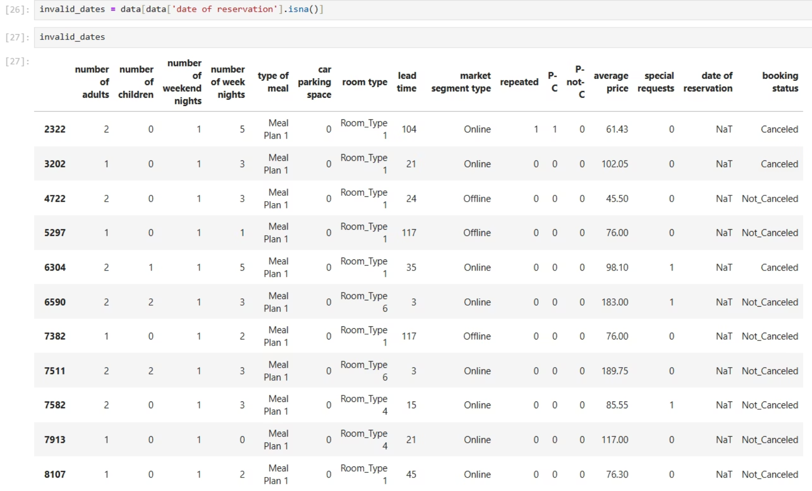
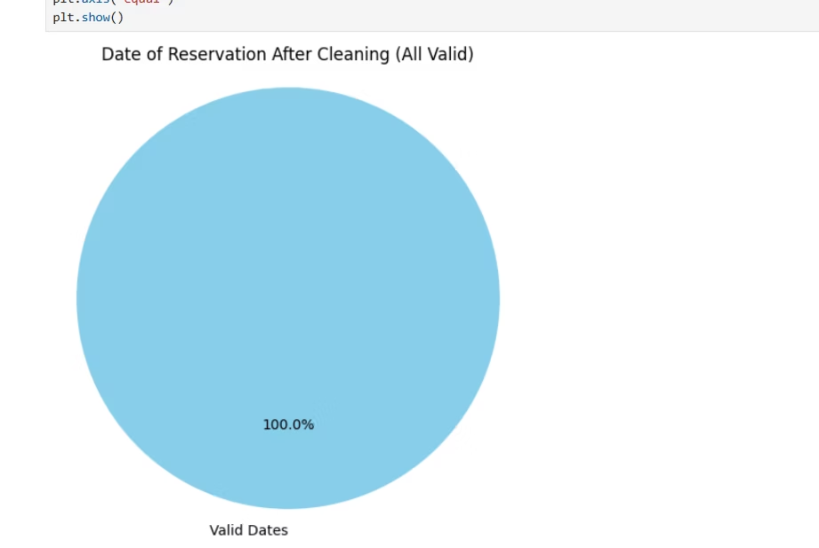
SPOTTED AND HANDLED INVALID DATES
Number of invalid dates was 35, out of 26009 data, accounting for 0.13%. of the whole data set
These entries were removed to ensure the accuracy and consistency of our time-based analyses, such as booking trends, lead time calculations, and seasonality insights.
This minor adjustment enhances data integrity without impacting the overall quality or representatives of the dataset.

Slide 8

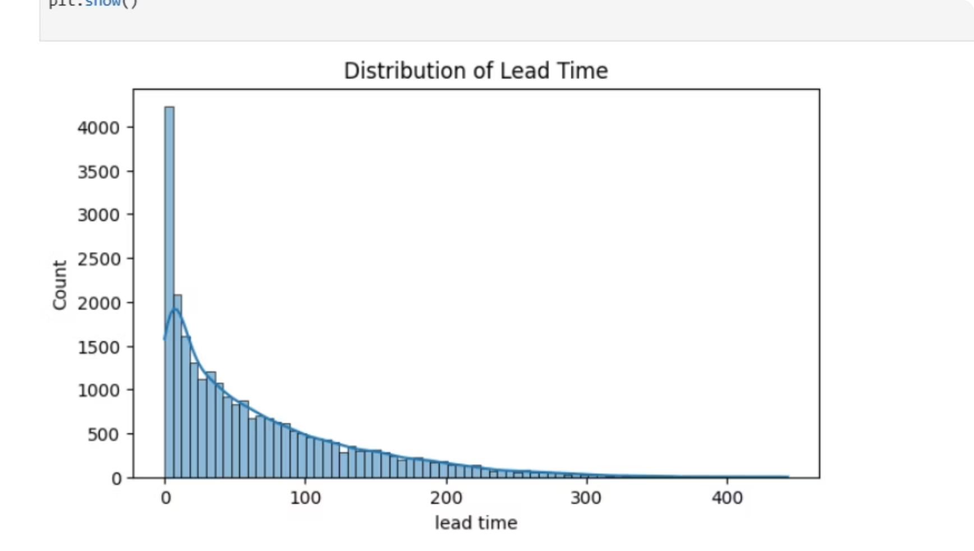
EXPLORATORY DATA ANALYSIS
Lead Time Distribution(UNIVARIATE)
Last-Minute Bookings
Early Planners
Most customers book just days or weeks before their stay, creating a right-skewed distribution.
A smaller group books months in advance, forming the extended right tail of the distribution.
Business Implications
Last-minute bookings are common while early planners are relatively rare, suggesting opportunities for targeted marketing strategies.

Slide 9
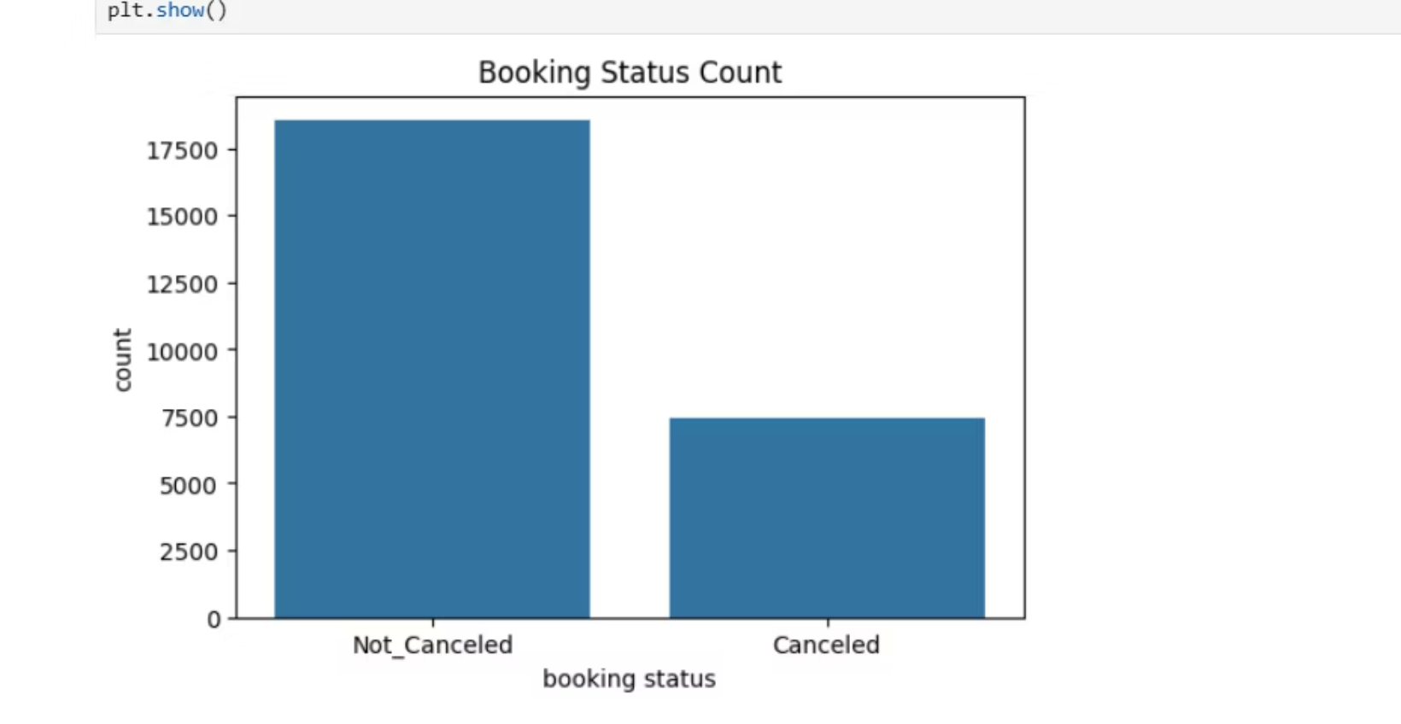
BOOKING STATUS COUNT
Fewer cancellations reflects a well-optimized user experience
Cancellation Policies Are Effective , and can have non-refundable, penalized, or limited cancellation windows.
Such policies often discourage casual or impulsive cancellation

Slide 10
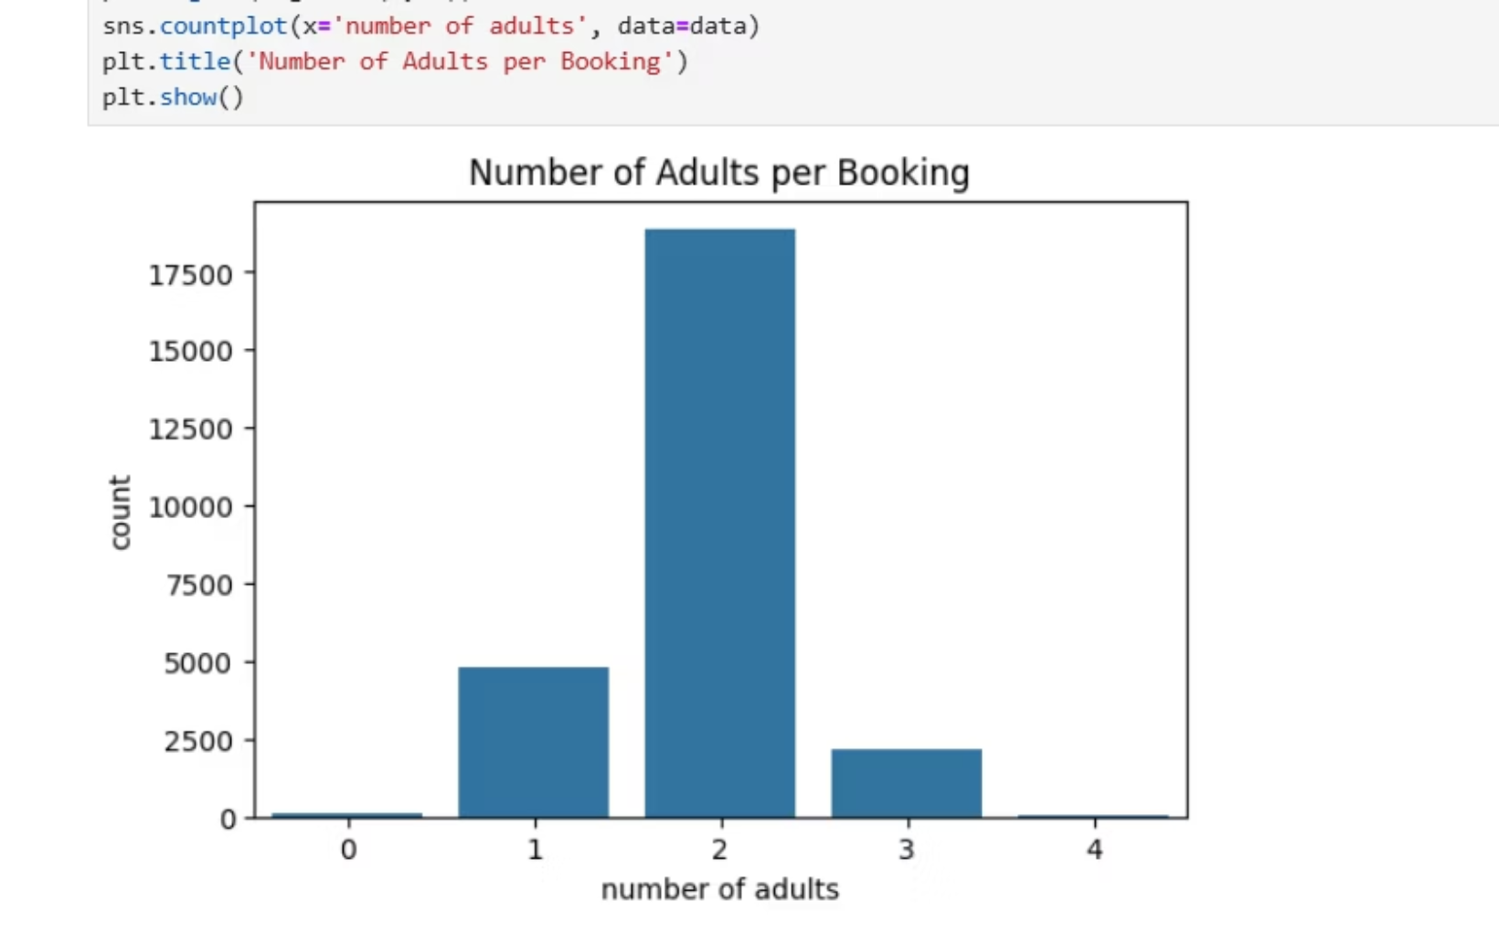
This is typical in hospitality. Many hotel rooms are designed for 2 adults.
Hotels may mostly offer rooms meant for 2 adults, aligning with demand.
this Suggests good alignment between supply and market preference.
Less Demand for Solo or Group Bookings
Bookings with 1 adult or 3+ adults are much fewer.
indicates hotels are less attractive or optimized for solo travelers or large groups.
Pricing Strategy May Favor Pairs
Prices or promotions may be more affordable for two, making it the “sweet spot”

Slide 11
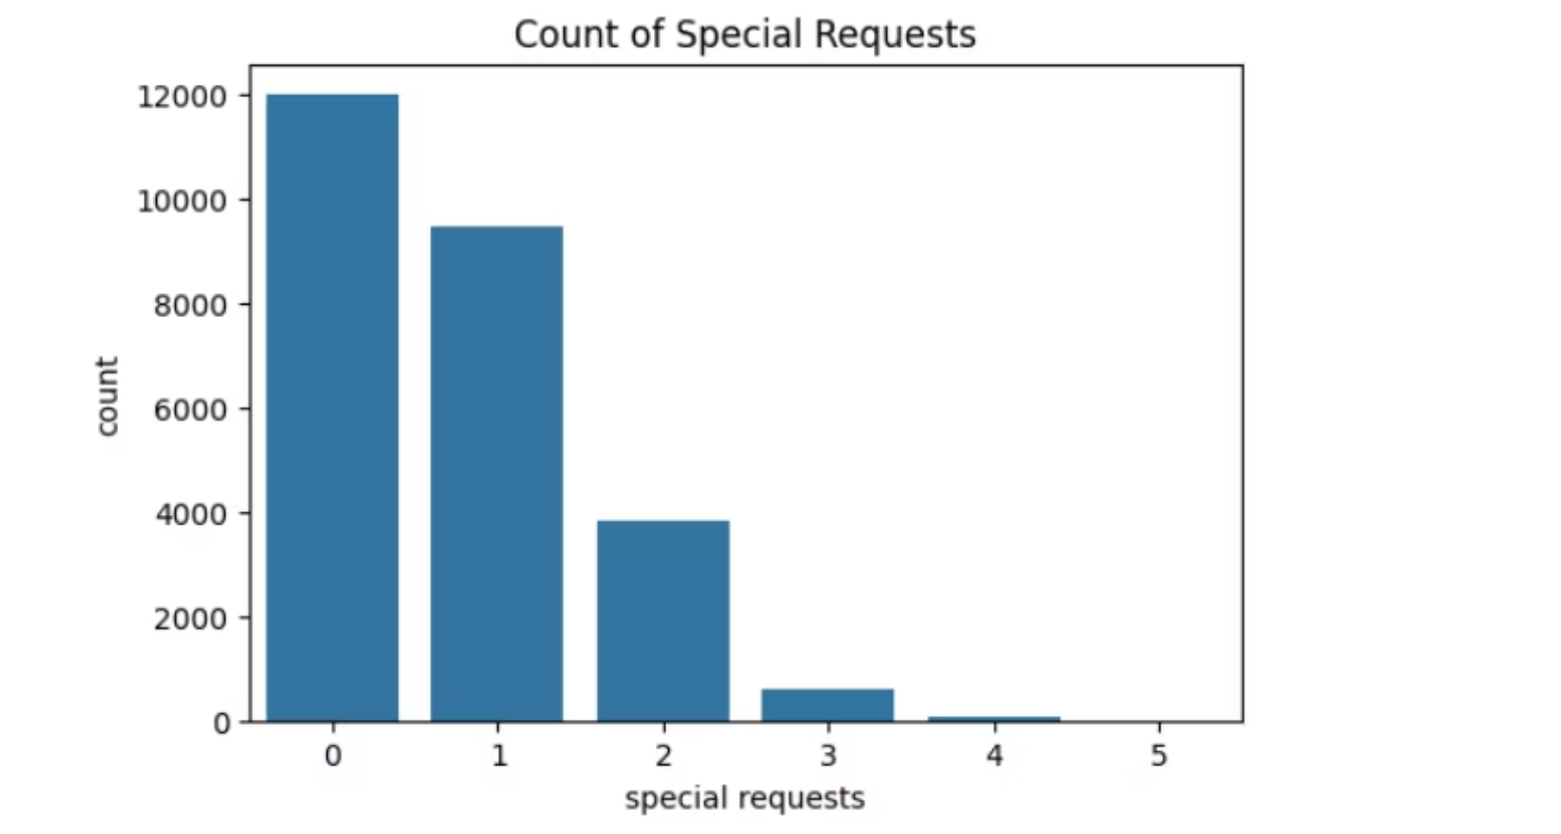
Count of special request
A majority of customers (value 0) did not request anything extra.
Could indicate: Standard services meet most needs., Guests are not aware they can make special requests. ,Booking platforms don’t emphasize or offer this feature clearly.

Slide 12
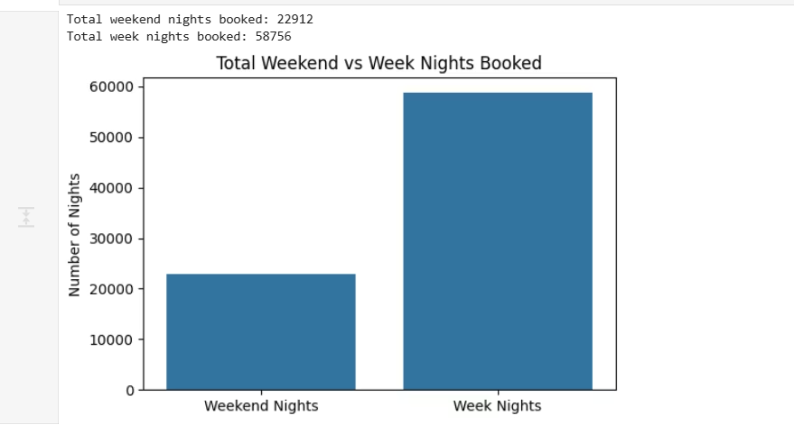
BI-VARIATE ANALYSIS
WEEKEND NIGHT VS WEEKDAY NIGHT
More total nights are booked during the weekdays than weekends.
Guests tend to stay more often on weekdays (Monday to Friday) than on weekends (Saturday and Sunday).

Slide 13
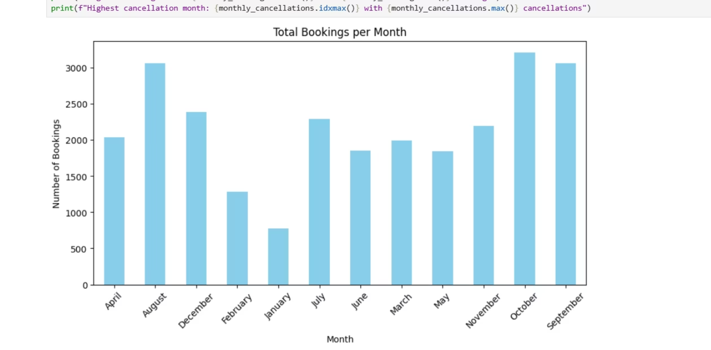
Bookings per month
As seen in the chat, January has the lowest number of booking and October has the highest number of booking,

Slide 14
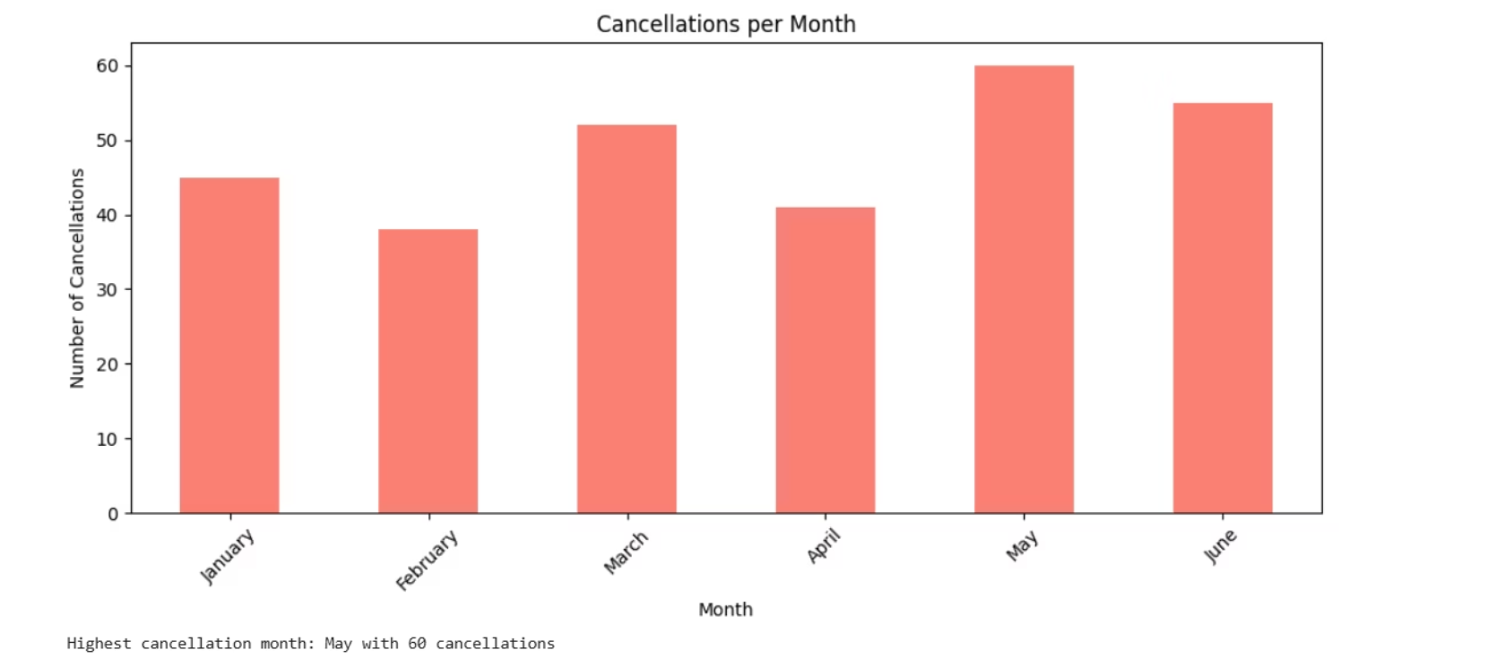
Cancellations per month
Lowest cancellations were recorded in February and April, suggesting stronger booking commitments or possibly fewer reservations during these months.
In contrast, May, June, and March experienced notably high cancellation volumes, with May having the highest.
These patterns may be influenced by seasonal travel plans, promotional periods, or external factors such as school holidays or weather-related changes.
Understanding these trends allows us to refine our booking policies, adjust overbooking strategies, and target customer engagement efforts more effectively during high-risk months.

Slide 15
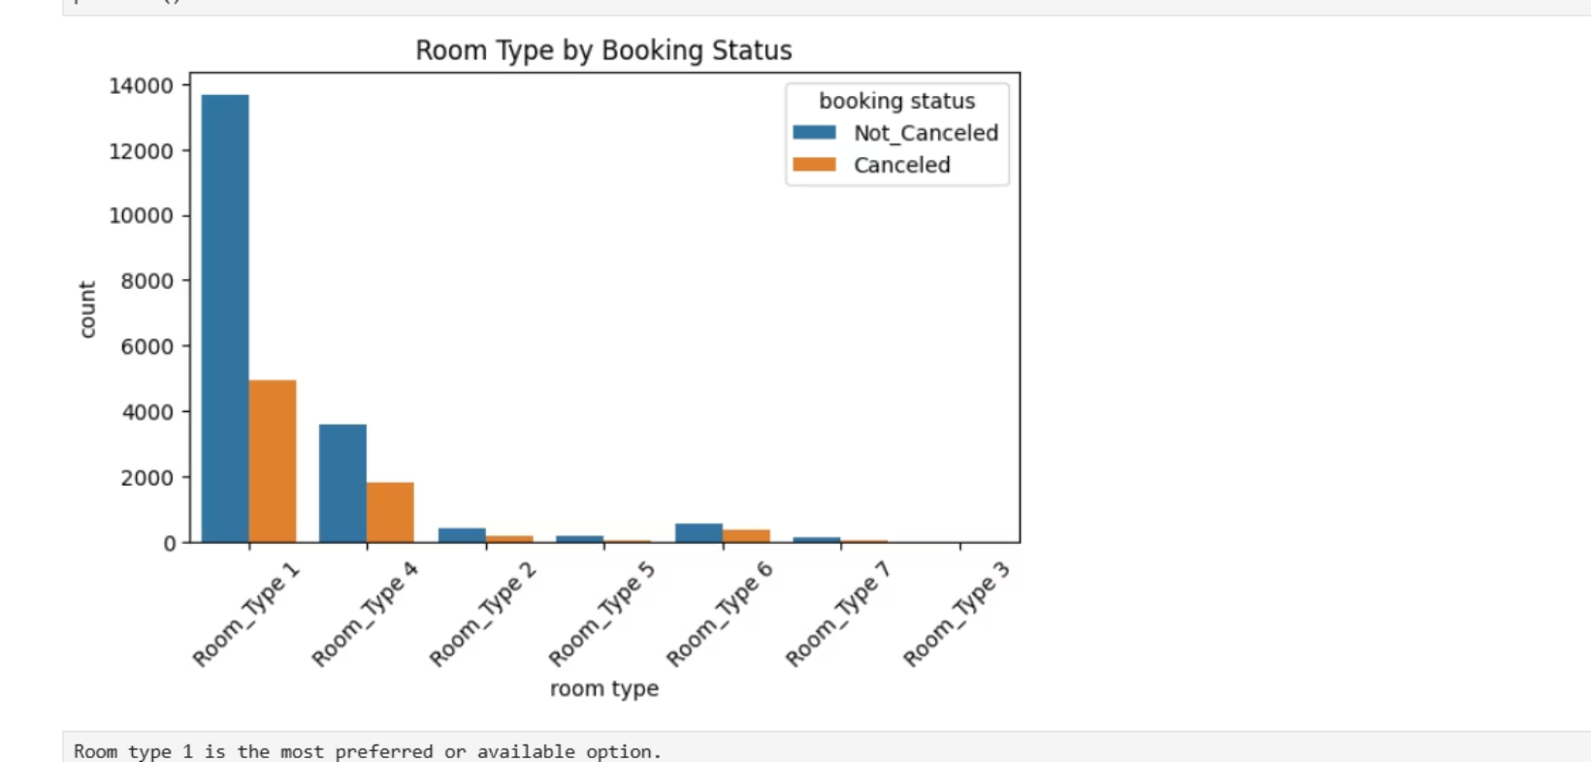
ROOM TYPE BY BOOKING STATUS
Guests mostly book this room type 1
Probably offers the best value, most comfort, or is the most advertised.
The high count of not canceled bookings for room type 1 suggests that guests who book this room are more likely to follow through with their stay.
Room type 2 and others might be:
Less available,less advertised , Less popular due to price, size, or amenities, Or maybe targeted at niche customers.

Slide 16
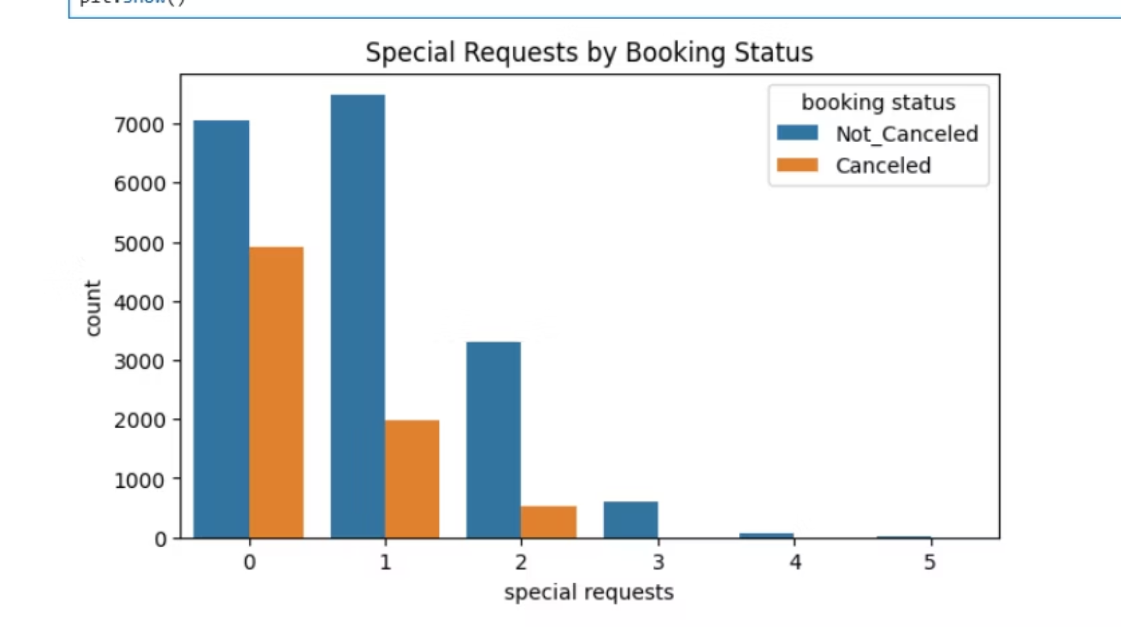
Special request by booking status
Guests who made at least 1 special request tend to cancel less. which means they are more engaged or serious about their stay.
Making a request could indicate a higher commitment level.
Guests with no special requests cancel more often. :Some might book casually or be less invested in the stay

Slide 17
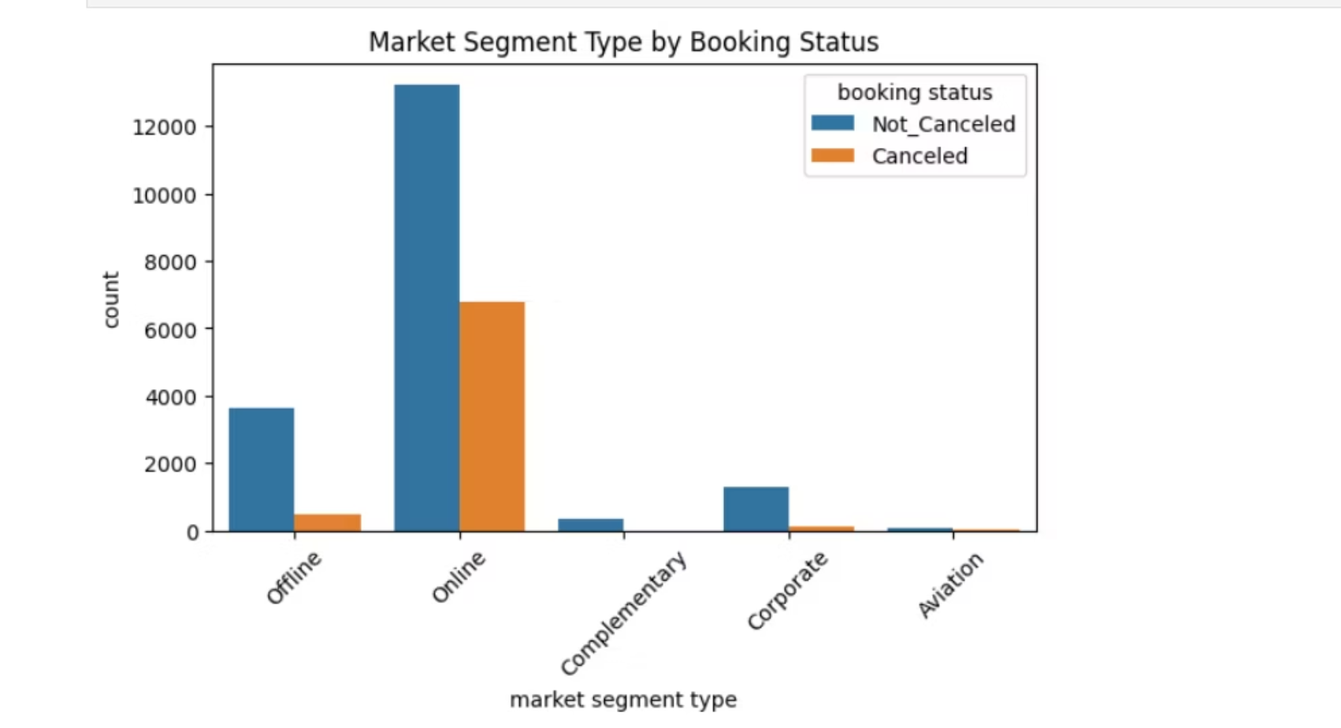
Market segment by booking status
Online platforms often allow quick, easy cancellations with fewer penalties.
Guests may book multiple options online and cancel later (“booking shopping”).
Lower Commitment in Online Bookings
Customers booking online may be more price-sensitive or less committed.
Impulsive bookings or uncertain plans can lead to higher cancellations.
Offline Bookings Often Involve More Personal Contact
More effort invested by guest leads to higher commitment and fewer cancellations.
Different Cancellation Policies
Online channels might have more flexible cancellation policies.
Offline bookings may have stricter terms.

Slide 18
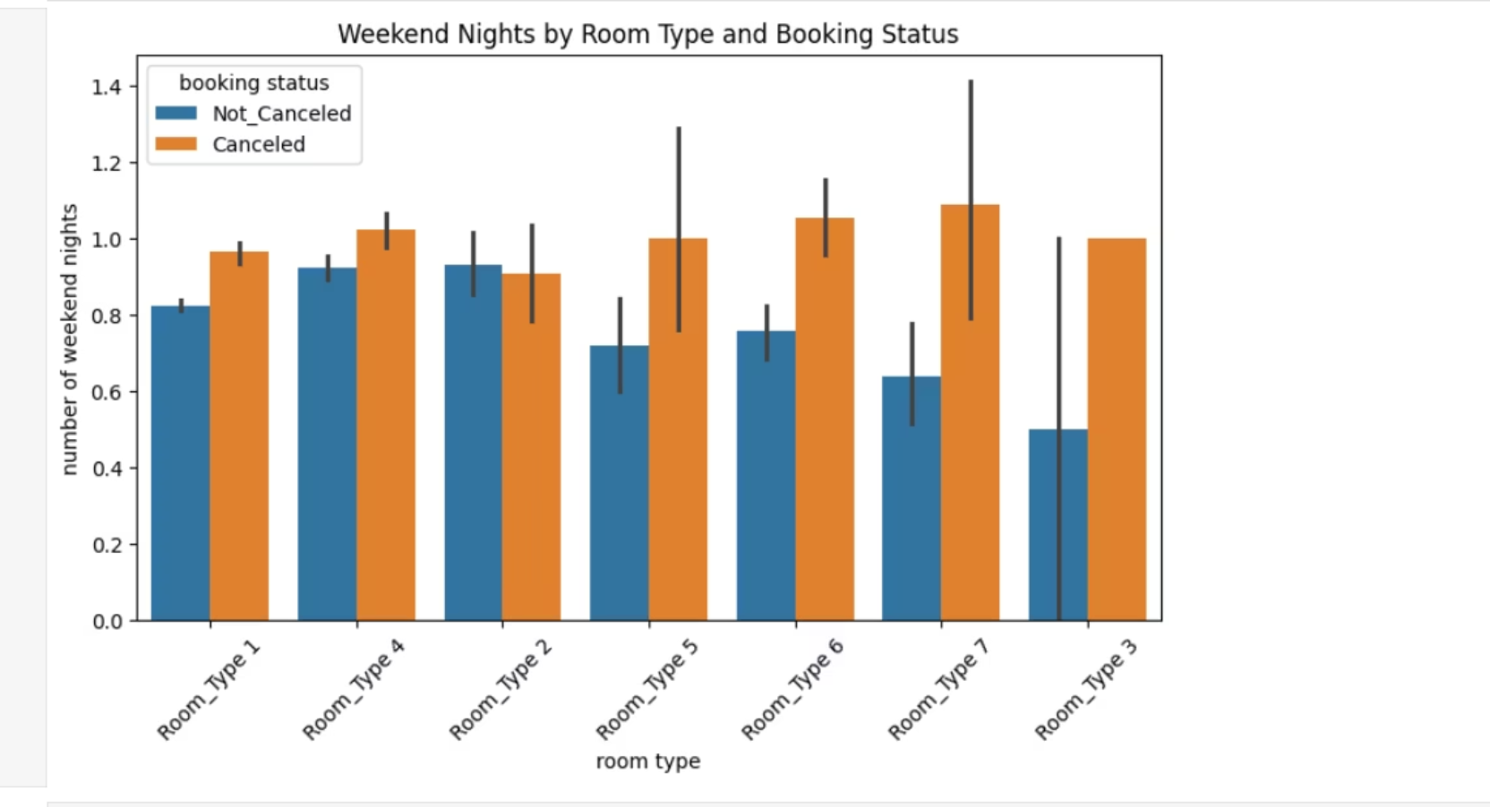
MULTIVARIATE ANALYSIS
Guests booking more weekend nights are canceling more often than guests booking fewer weekend nights.
This could suggest that weekend plans are more likely to change or be uncertain.
Room type 1, 4, and 2 dominate bookings: These are your most popular room types, so naturally they show higher booking activity.
Does this mean people cancel more on weekends? Not necessarily the weekends themselves, but rather longer weekend stays are more likely to be canceled.
Weekend trips might be more subject to last-minute changes, like social plans, events, or weather.
Cancellations on weekend stays are due to factors like event changes, travel complications, or shifting social plans .

Slide 19
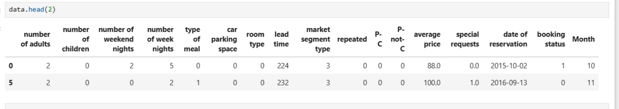
Feature engineering and model development
Encoded Categorical Variables by Converting categorical variables like type of meal, room type, and Market segment type, booking status, and month into numeric formats.

Slide 20
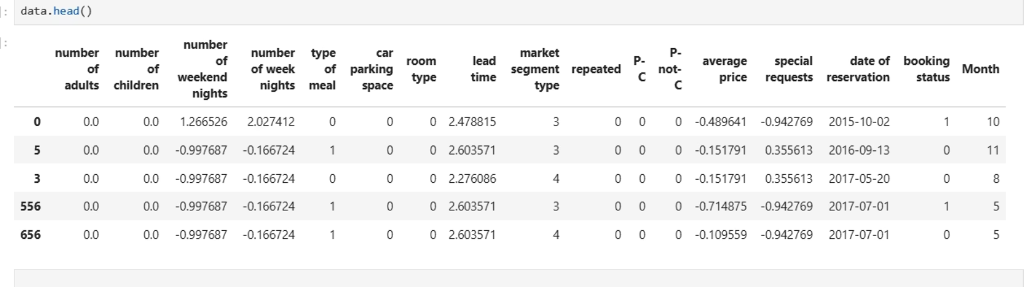
Feature engineering and model development
SCALING OF THE DATA Scaled Numerical Features, Scale numerical columns to bring them to a similar range, which can improve model performance.

Slide 21
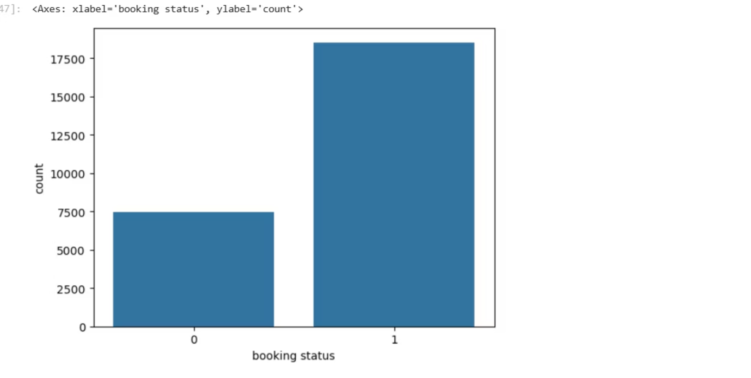
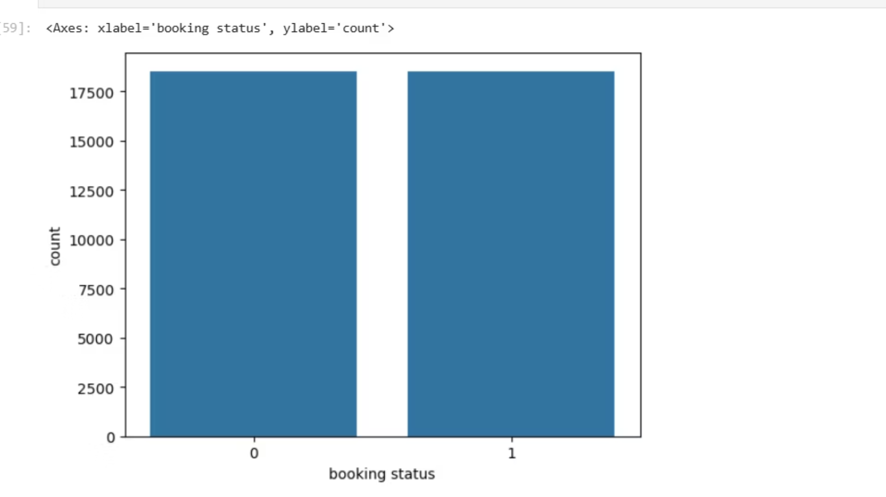
CLASS IMBALANCE AND OVERSAMPLING
After encoding categorical variables in the dataset,. The result revealed a class imbalance, where one class significantly outweighed the other.
Balancing the dataset at this stage is essential for achieving fair, reliable, and unbiased model performance during training and evaluation
To prevent the machine learning model from becoming biased toward the majority class, we plan to apply oversampling techniques (e.g., SMOTE or RandomOverSampler). This step ensures the model learns equally from both classes and improves its ability to generalize and predict minority outcomes effectively.
we applied oversampling techniques to increase the representation of the minority class. As a result, the number of samples in both classes is now equal, ensuring a balanced dataset.
.
This step is crucial for building a fair and robust predictive model, as it prevents the algorithm from being biased toward the majority class.

Slide 22
MODEL SELECTION
We’ll train multiple classification models to find the best one for predicting attrition. Start with a baseline and expand to more advanced models.

Slide 23
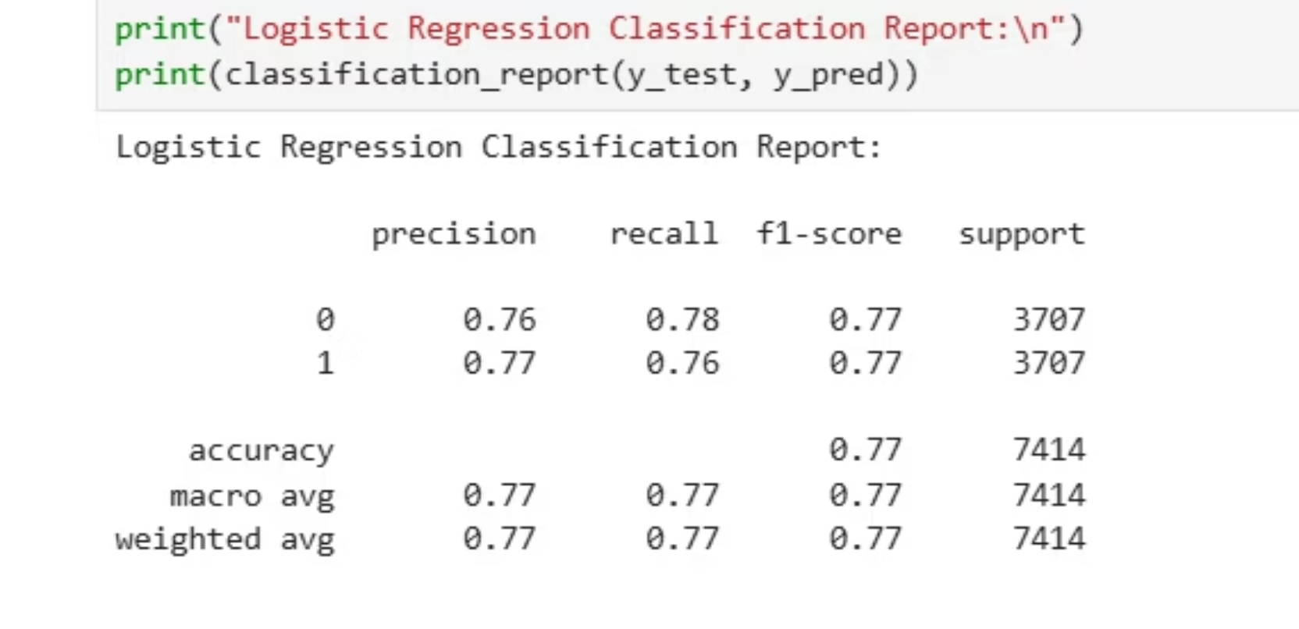
Model Selection: Logistic Regression Performance
The Logistic Regression model was evaluated on the balanced dataset, yielding the following classification metrics:
Accuracy: 77%
Precision: Approximately 76-77% for both classes
Recall: Approximately 76-78% for both classes
F1-Score: Balanced at 77% for both classes
The model demonstrates consistent and balanced performance across both classes (0 and 1), indicating it can effectively distinguish between confirmed and cancelled bookings without bias toward either class.
This solid baseline performance supports Logistic Regression as a strong candidate for further tuning and comparison with other models during the model selection phase.

Slide 24
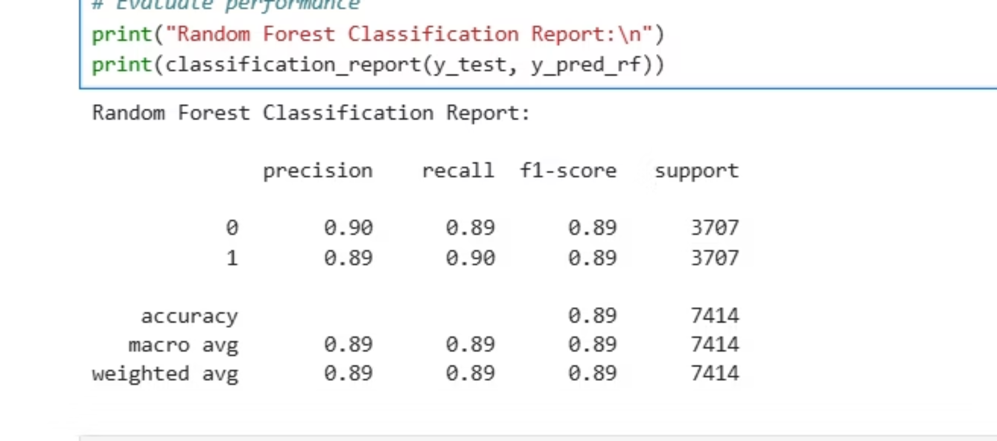
Random Forest Performance
The Random Forest classifier was evaluated on the balanced dataset, achieving strong predictive performance:
Accuracy: 89%
Precision: Approximately 89-90% for both classes
Recall: Approximately 89-90% for both classes
F1-Score: Balanced at 89% for both classes
These metrics indicate that the Random Forest model delivers robust and consistent classification results, effectively distinguishing between confirmed and cancelled bookings with high accuracy and minimal bias.
Compared to the Logistic Regression baseline, the Random Forest shows a significant improvement in all key performance metrics.

Slide 25
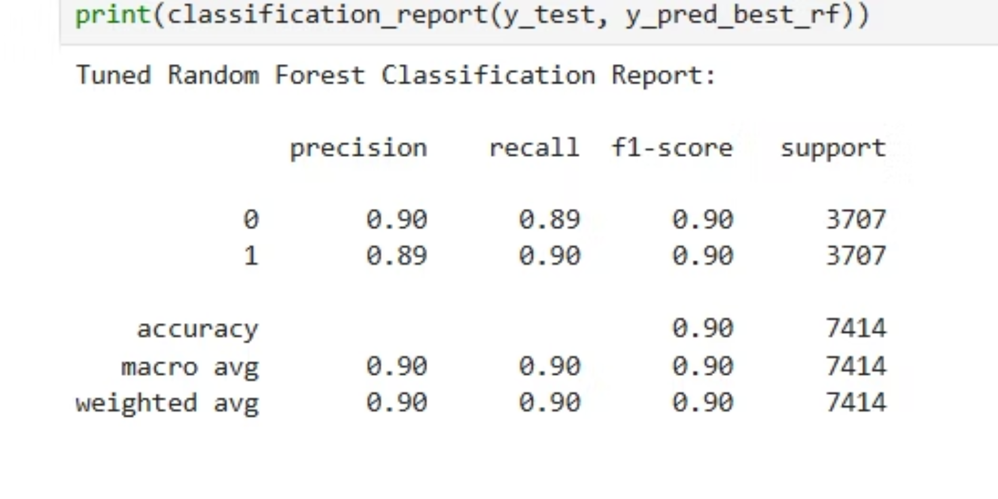
Tuned Random Forest: Improved Model Performance
After applying hyperparameter tuning to the initial Random Forest model, we observed a measurable improvement in performance across all key metrics:
Accuracy: 90%
Precision: 90% (Class 0), 89% (Class 1)
Recall: 89% (Class 0), 90% (Class 1)
F1-Score: 90% for both classes
Support: 3,707 samples per class (balanced dataset)
Key Highlights:
The model shows high precision and recall for both booking outcomes — confirmed and cancelled.
Balanced F1-scores reflect strong, consistent predictive capability.
Tuning enhanced the model’s ability to generalize, minimizing bias and overfitting.

Slide 26
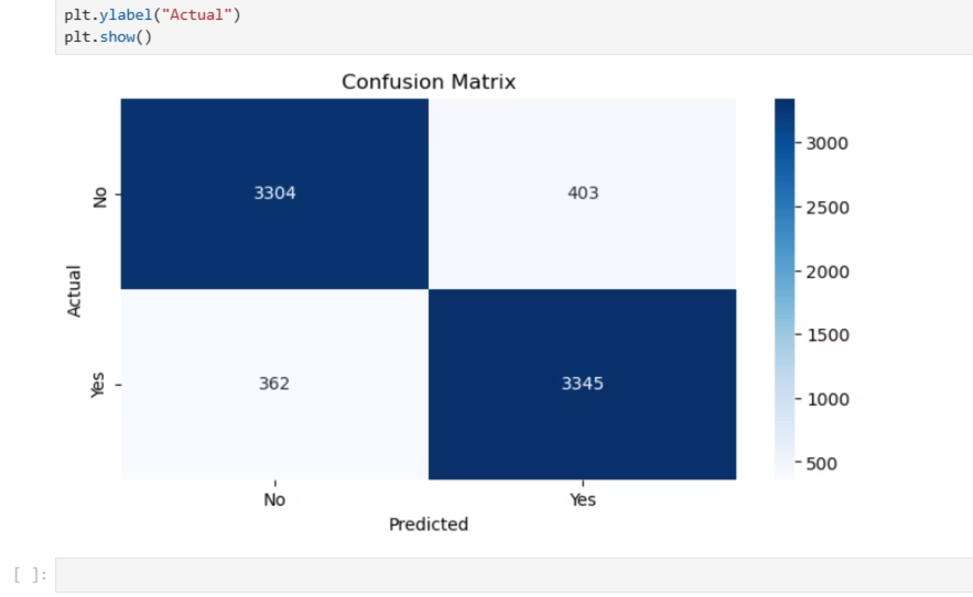
CONFUSION METRICS
True Positives (3,345): Model correctly predicted cancellations.
True Negatives (3,304): Model correctly predicted non-cancellations.
False Positives (402): Model predicted cancellation when it was not.
False Negatives (362): Model predicted no cancellation when it was actually cancelled.
Insights:
The model correctly classified 89% of bookings.
False positive and false negative rates are relatively low, indicating a well-balanced model.
Strong performance in both classes confirms that the model generalizes well across booking statuses.

Slide 27
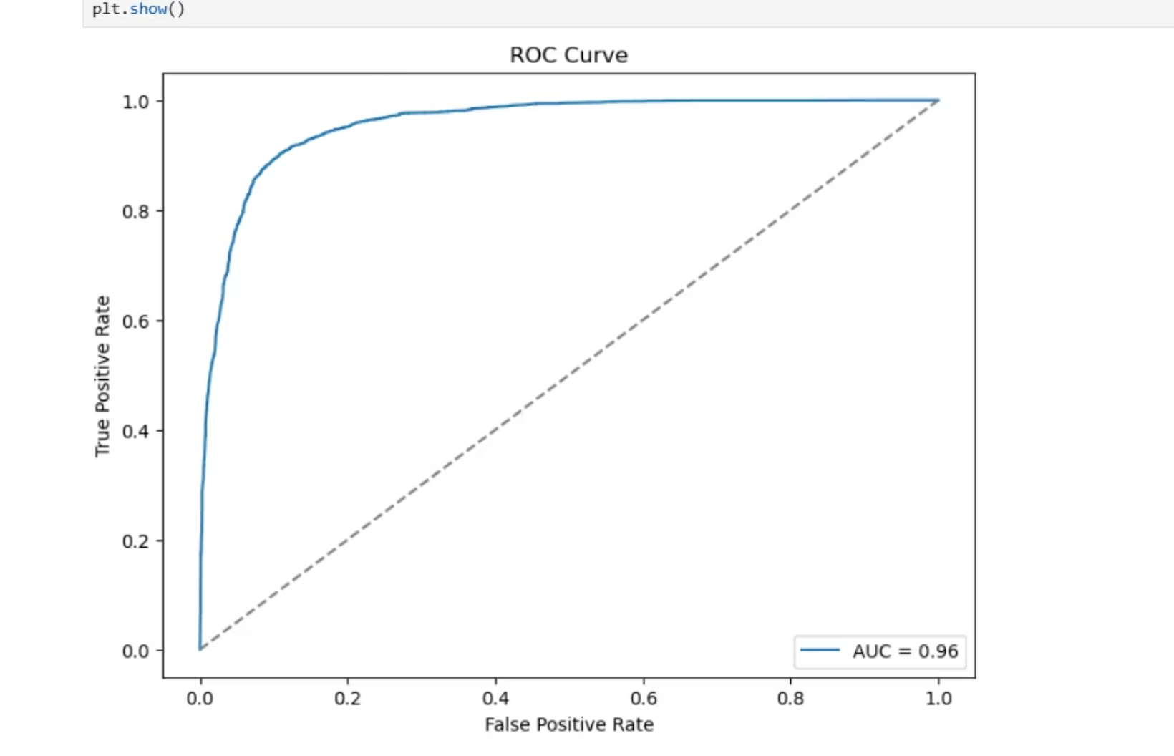
ROC Curve and AUC Score
As part of evaluating our model’s predictive power, we calculated the ROC AUC score, which measures the model's ability to distinguish between bookings that are likely to be cancelled and those that are not.
Our model achieved a ROC AUC score of 0.96 (out of 1.00). this means the model can correctly differentiate between cancelled and non-cancelled bookings 96% of the time and This indicates very high performance in identifying risk of cancellations, even before they happen.

Slide 28
INSIGHTS AND RECOMMENDED STRATEGIES
High Cancellation Months Identified (May, June, April)
Lead Time Correlation
Frequent Cancellers Can Be Profiled
Insight: Bookings with very long lead times (i.e., booked far in advance) show higher cancellation rates
.Solution: Add incentives for early bookings to stay (e.g., non-refundable discounts or perks for holding the reservation).
Insight: Some guests, especially repeat users, have a higher tendency to cancel
.Solution: Use this model to flag high-risk bookings early and consider confirmation follow-ups or deposits for repeat cancellers.
Insight: Cancellations spike during specific months.
Solution: Introduce stricter cancellation policies or flexible pricing options during these peak months to reduce risk.

Slide 29
High Number of Special Requests
Room Booking Characteristics Matter
Balanced Data Helps Predict Better
Insight: Bookings with many special requests often result in cancellations possibly due to unmet expectations.Solution: Improve communication and confirmations on special requests to manage guest expectations better.
Insight: Specific patterns (e.g., low number of adults or children, short stays) are more cancellation-prone.Solution: Use predictive modeling at booking time to flag potentially risky reservations and offer personalized incentives.
Insight: After oversampling and balancing your data, the model achieved 90% accuracy and a 0.96 ROC AUC, meaning it's highly effective at detecting likely cancellations.Solution: Integrate the model into the booking system to score each reservation and trigger interventions when risk is high.

Slide 30

Most Cancellations Are Predictable
Insight: With precision, recall, and F1-scores all at 90%, most cancellations are not random — they follow patterns.Solution: Move from reactive to proactive cancellation management — use the model’s prediction to:
Send automated reminders
Offer loyalty points for honoring the booking
Require partial prepayment based on risk level

Slide 31

THANK YOU

